Slide 1

Moulay Ismail University
National School of Arts and Crafts
Department of Industrial Engineering and Production
Master’s Thesis Defense
Project Title :
Community Detection in Social Networks for Targeted Marketing and Recommender Systems
Presented by:
MOUDDEN Hamza
Supervised by:
Pr.ELYAZID Akachar
Academic Year: 2025 - 2026

Slide 2
Presentation Outline
01
05
Introduction & Problem Statement
Experimental Results
02
06
Background & Key Concepts
Recommender System Integration
03
07
Literature Review
Web Application
04
08
Methodology
Conclusion & Future Perspectives

Slide 3
Introduction
Social media platforms generate massive networks of user interactions.
    Facebook: 2+ billion active users.
Interactions include likes, shares, comments, follows.
These interactions form intricate networks revealing patterns of human connection.

Slide 4
Problem Statement
Despite numerous community detection algorithms available, selecting the right one remains challenging:
Algorithmic Diversity Different principles (modularity optimization, random walks, deep learning).
Evaluation Gap Most studies use modularity that don't predict practical usefulness.
Limited Comparison Modern vs. classical methods not systematically compared, especially at scale.
Practical Utility Lack of unified evaluation framework for real-world applications.
Research Question: How do different community detection approaches compare in effectiveness and practical utility for recommender systems?

Slide 5
Research Objectives
Study and categorize community detection approaches (classical & modern)
Implement representative algorithms from different categories
Apply algorithms to real-world and synthetic network datasets
Evaluate using structural metrics (modularity, NMI, ARI)
Assess practical usefulness for targeted marketing & recommendation
Compare performance and identify strengths/limitations
Provide insights on trade-offs between simplicity, scalability, and effectiveness
Build an interactive web application for illustration.

Slide 6
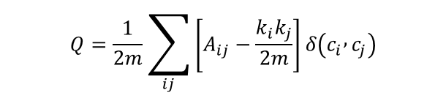
Background - Community Detection
What is a Community?
Definition: Groups of nodes with denser internal connections than external connections
Community Types:
Disjoint: Each node belongs to exactly one community
Overlapping: Nodes can belong to multiple communities (clique percolation)
Modularity (Q): Compares internal edges vs expected in random graph
$$Q=\frac{1}{2m}\sum_{ij}{\left[A_{ij}−\frac{k_{i}k_{j}}{2m}\right]}δ\left(c_{i} , c_{j}\right)$$
Interpretation: High Q = strong community structure Limitation: Resolution limit for small communities (Fortunato, 2010)

Slide 7
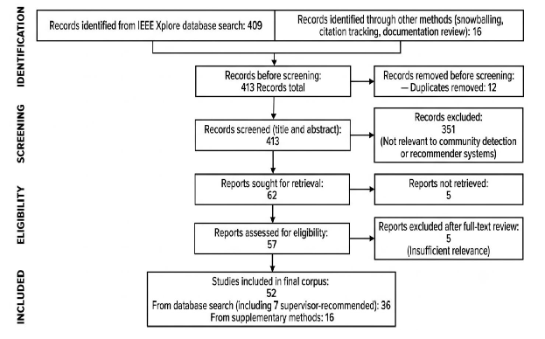
Literature Review - Methodology
Prisma flow diagram

Slide 8
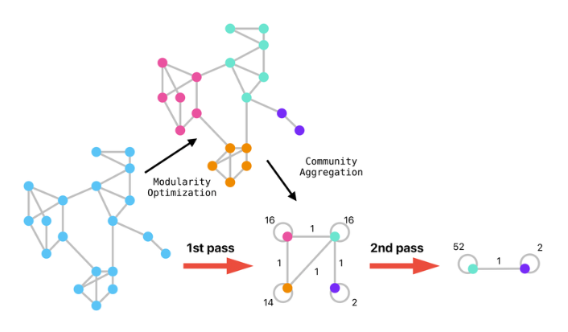
Literature Review - Classical Algorithms
Modularity-Based Approaches
Algorithm | What It Does | Limitation
Louvain (Blondel et al.) | Greedy modularity optimization. | Traag et al.: up to 25% communities poorly connected.
Leiden (Traag et al., 2019) | Guarantees well-connected communities. | Sliwa et al.: detected 97 vs. 41 communities vs. Louvain.

Slide 9
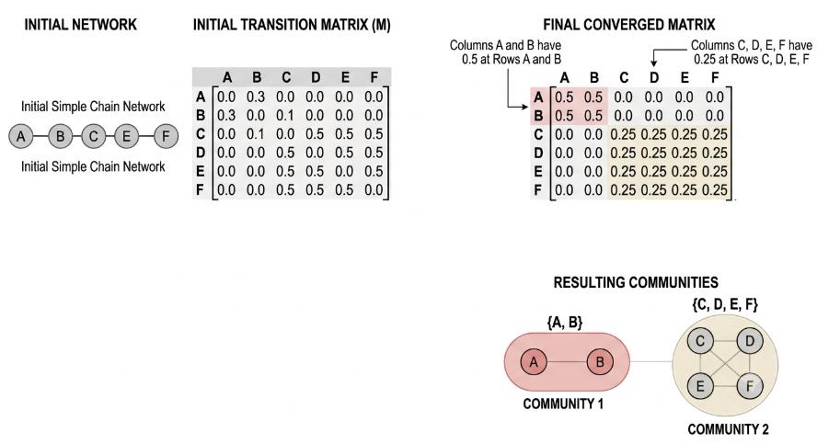
Literature Review - Classical Algorithms
Random Walk-Based Approaches
Algorithm | What It Does | Limitation
Walktrap (Pons & Latapy) | Random walks trapped in dense regions. | Gates et al.: strong on flow-based networks.
Infomap (Rosvall & Bergstrom). | Minimizes map equation. | Yang et al.: linear time, top performer
MCL (van Dongen) | Expansion + inflation operators. | Papadopoulos et al.: pre-weighting improves NMI 0.4→0.8.

Slide 10
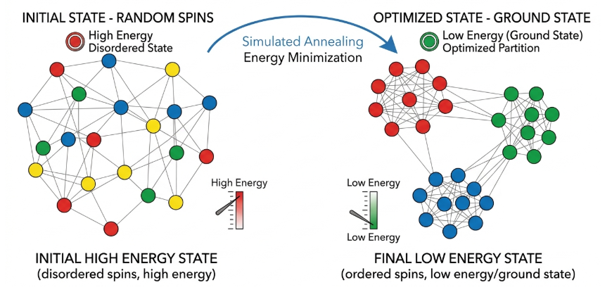
Literature Review - Classical Algorithms
Statistical Physics-Based Algorithms - SpinGlass

Slide 11
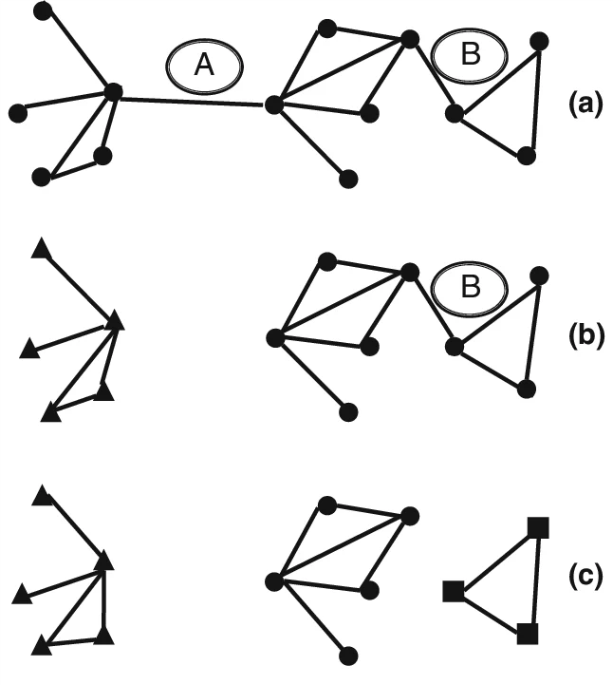
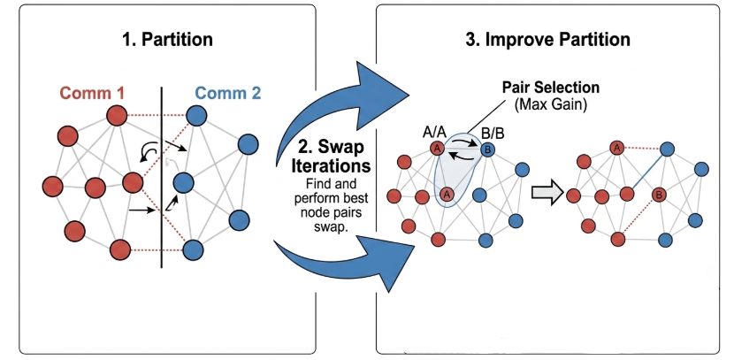
Literature Review - Classical Algorithms
Divisive Approaches
Algorithm | What It Does | Limitation
Girvan-Newman | Removes highest betweenness edges | Gates et al.: O(n³), impractical beyond few thousand nodes.
Kernighan-Lin (1970) | Greedy bisection with local search | Li et al.: requires equal-sized partitions.

Slide 12
Literature Review - Classical Algorithms
Label Propagation Approaches
Algorithm | What It Does | Limitation
LPA (Raghavan et al.) | Nodes adopt most frequent neighbor label. | Gates et al.: fundamentally unstable.
FLPA | Asynchronous updates + memor.y | Yang et al.: outperforms LPA for μ ∈ [0.5, 0.7].
LPA-MNI (Li et al.) | Modularity + node importance. | Enhanced accuracy and robustness.
CLPA (Li et al.) | Constrained optimization. | Versatile for different network types.
FluidC (Parés et al.) | Communities as expanding fluids. | Anuar et al.: ARI ~0.9 on 500K nodes.

Slide 13
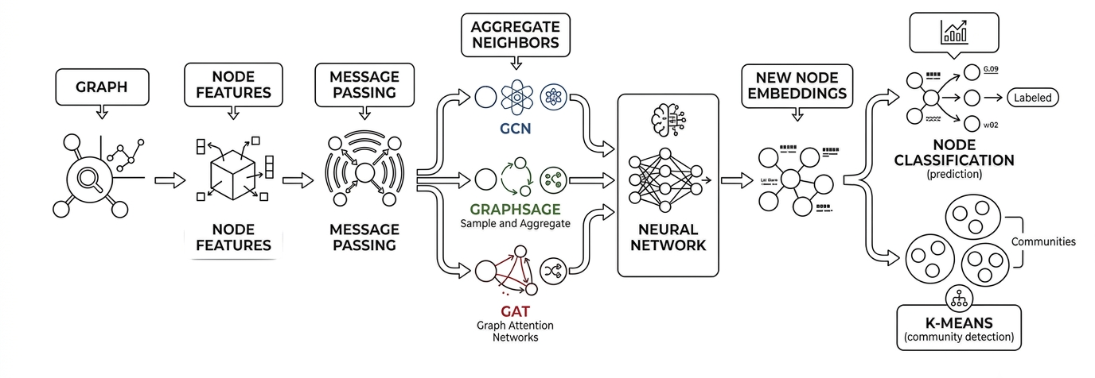
Literature Review - Modern Approaches
Graph Neural Networks (GCN – GraphSage – GAT)

Slide 14
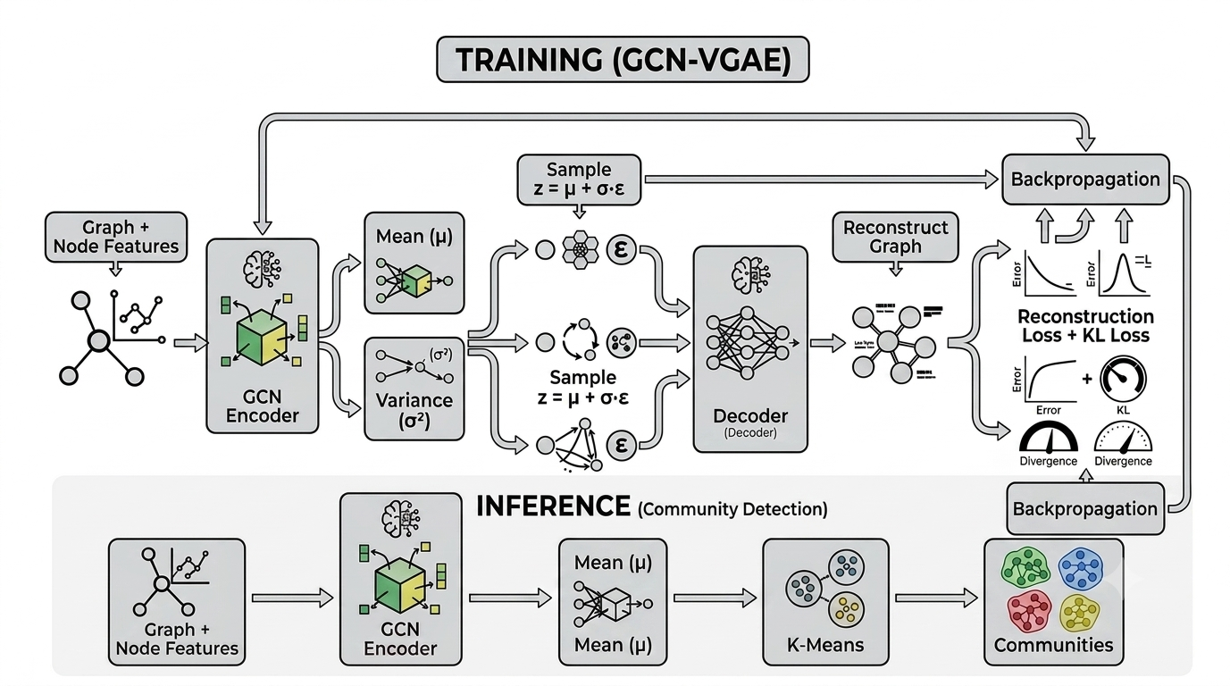
Literature Review - Modern Approaches
Graph Neural Networks (AE – VGAE)

Slide 15
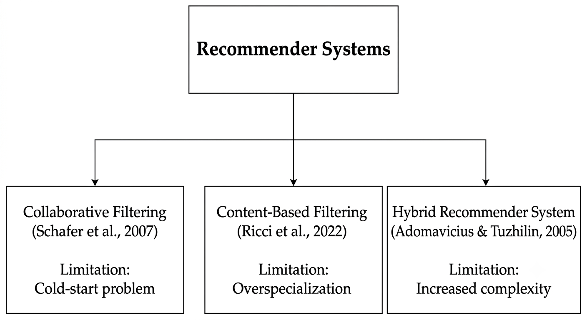
Literature Review - Recommender Systems
Three Classical Approaches
Challenges : Data Sparsity – Cold Start – Scalability – Interpretability.

Slide 16
Literature Review - Applications
Targeted Marketing and E-Commerce
Study | Application | Results
Paul et al. (2025) | Commerce Graph. | Customers with high centrality enable personalized promotions.
Nasirzonouzi (2025) | Customer segmentation. | Reveals complex interrelations K-means fails to capture.
Kanavos et al. (2024) | Twitter community analysis. | Community structures influence information dissemination.

Slide 17
Literature Review - Applications
Recommender Systems Applications
Study | Application | Results
Saikalyan et al. (2024) | Local community detection | Effective cold-start on MovieLens and Facebook
Hu et al. (2024) | GGCRF framework | Addresses long-tail effect in recommendation
S.K.S. et al. (2025) | Textual semantics + GNNs | Improves community detection accuracy

Slide 18
Literature Review - Applications
Standard Benchmark Datasets
Dataset | Nodes | Edges | Communities
Karate Club (Zachary, 1977) | 34 | 78 | 2
Dolphins (Lusseau et al.) | 62 | 159 | 2
Football (Girvan & Newman) | 115 | 613 | 12
Polbooks (Krebs, 2004) | 105 | 441 | 3
Primary School (Stehle et al., 2011) | 236 | 125,000 | 10
Facebook (McAuley & Leskovec, 2012) | 4,039 | 88,234 | 34
LastFM (McAuley & Leskovec, 2012) | 28,281 | 92,752 | 18
LFR Synthetic Benchmark (Lancichinetti et al., 2008)

Slide 19
Literature Review - Applications
Proposed Hybrid Approaches
User-Based
Item-Based
SVD + Community
ALS + Community
BM25 + Community
How They work
Community structure → Constrains candidate space, reduces sparsity.
Latent factors (SVD/ALS) → Captures fine-grained preferences.
BM25 → Leverages statistical co-purchasing patterns.

Slide 20
Methodology Overview
Phase 1: Community Detection Evaluation
Category | Algorithms | Datasets | Metrics
Classical (13) | Louvain, Leiden, Walktrap, Infomap, LPA, FLPA, LPA-MNI, CLPA, FluidC, Girvan-Newman, Kernighan-Lin, SpinGlass, MCL | 9 real-world + LFR synthetic (6 sizes) | NMI, ARI, Modularity
Deep Learning (4) | GCN, GAT, VGAE, Autoencoder | 9 real-world + LFR synthetic | NMI, ARI, Modularity
Phase 2: Recommender System Integration
Recommendation Approaches: User-Based, Item-Based, SVD+Community, ALS+Community, BM25+Community.
Dataset: UCI Online Retail (541,909 transactions)
Primary Metric: F1@5
Phase 3: Web Application

Slide 21
Methodology Overview – Datasets Used
Datasets Summary
Dataset | Karate Club | Dolphins | Football | Polbooks | Primary School | Facebook | LastFM
Nodes | 34 | 62 | 115 | 105 | 236 | 4,039 | 28,281
LFR Synthetic Networks
Parameter | Values
Network Size (n) | 500, 1,000, 5,000, 10,000, 50,000, 100,000
Mixing Parameter (μ) | 0.3, 0.5, 0.7

Slide 22
Methodology Overview - Evaluation Metrics
Community Detection Metrics
Metric | Purpose | Range
Modularity (Q) | Quality without ground truth | [-0.5, 1.0]
NMI | Similarity to ground truth | [0, 1]
ARI | Similarity adjusted for chance | [-1, 1]
Recommender System Metrics (@K)
Precision@K : Relevant items in top-K / K
Recall@K : Relevant in top-K / Total relevant
F1@K : 2 × (Precision × Recall) / (Precision + Recall)

Slide 23
Results - Classical Algorithms
Community Detection Metrics - Modularity
Algorithm | Karate | Dolphins | Football | Polbooks | PS | VS13 | VS15 | FB | LastFM
Louvain | 0.4151 | 0.5233 | 0.6046 | 0.5272 | 0.3708 | 0.3857 | 0.3415 | 0.813 | 0.8154
Leiden | 0.4198 | 0.5276 | 0.6046 | 0.5269 | 0.3758 | 0.3857 | 0.3417 | 0.8179 | 0.8179
Walktrap | 0.3532 | 0.4888 | 0.6029 | 0.507 | 0.3375 | 0.3794 | 0.3188 | 0.7519 | 0.7727
Infomap | 0.402 | 0.5247 | 0.6005 | 0.5268 | 0.3758 | 0.3857 | 0.2849 | 0.754 | 0.7349
LPA | 0.4033 | 0.5205 | 0.6032 | 0.5154 | 0.2687 | 0.3718 | 0.2654 | 0.7607 | 0.7976
FLPA | 0.4151 | 0.5194 | 0.6046 | 0.5262 | 0.3589 | 0.3742 | 0.2654 | 0.7411 | 0.7584
LPA-MNI | 0.39 | 0.5258 | 0.601 | 0.5248 | 0.3631 | 0.3741 | 0.2932 | 0.7494 | 0.767
CLPA | 0.4174 | 0.5177 | 0.6046 | 0.5251 | 0.3754 | 0.3857 | 0.3415 | 0.8141 | 0.8147
FluidC | 0.3758 | 0.4583 | 0.5671 | 0.4108 | 0.2519 | 0.27 | 0.2207 | 0.6733 | 0.5651
G-Newman | 0.3488 | 0.3815 | 0.4549 | 0.4831 | 0.0008 | 0.0001 | 0 | Slow | Slow
K-Lin | 0.384 | 0.4197 | 0.5319 | 0.4297 | 0.2825 | 0.2594 | 0.2587 | 0.7174 | 0.7263
SpinGlass | 0.4158 | 0.5285 | 0.6015 | 0.5259 | 0.3758 | 0.3855 | 0.3416 | Slow | Slow
MCL | 0.36 | 0.455 | 0.6005 | 0.5138 | 0.2819 | 0.1311 | 0.2659 | 0.637 | 0.4126

Slide 24
Results - Classical Algorithms
Community Detection Metrics - NMI
Algorithm | Karate | Dolphins | Football | Polbooks | PS | VS13 | VS15 | FB | LastFM
Louvain | 0.6 | 0.4843 | 0.8903 | 0.5603 | 0.7805 | 0.8749 | 0.6329 | 0.2473 | 0.6278
Leiden | 0.5878 | 0.5524 | 0.8903 | 0.5737 | 0.8475 | 0.8749 | 0.6408 | 0.2479 | 0.6254
Walktrap | 0.4899 | 0.5816 | 0.8874 | 0.5427 | 0.6238 | 0.8662 | 0.5718 | 0.2967 | 0.583
Infomap | 0.5684 | 0.5373 | 0.9242 | 0.5369 | 0.8475 | 0.8749 | 0.598 | 0.2976 | 0.5277
LPA | 0.5056 | 0.6596 | 0.8866 | 0.5497 | 0.4169 | 0.8345 | 0.4284 | 0.2748 | 0.6294
FLPA | 0.6 | 0.6256 | 0.8903 | 0.5537 | 0.6307 | 0.8665 | 0.4284 | 0.276 | 0.5791
LPA-MNI | 0.5111 | 0.588 | 0.9269 | 0.5259 | 0.9281 | 0.8662 | 0.5703 | 0.2733 | 0.583
CLPA | 0.5925 | 0.5345 | 0.8903 | 0.5427 | 0.8072 | 0.8749 | 0.6329 | 0.2467 | 0.6307
FluidC | 0.4639 | 0.4807 | 0.8443 | 0.4003 | 0.8993 | 0.696 | 0.6848 | 0.2238 | 0.457
G-Newman | 0.6804 | 0.9085 | 0.4872 | 0.5754 | 0.0339 | 0.0435 | 0.0298 | Slow | Slow
K-Lin | 0.493 | 0.3819 | 0.7791 | 0.395 | 0.8071 | 0.6862 | 0.6169 | 0.068 | 0.3771
SpinGlass | 0.5622 | 0.5565 | 0.9065 | 0.4781 | 0.8475 | 0.8784 | 0.6448 | Slow | Slow
MCL | 0.7324 | 0.4386 | 0.9242 | 0.5209 | 0.4237 | 0.4425 | 0.4385 | 0.2885 | 0.4616

Slide 25
Results - Classical Algorithms
Community Detection Metrics - ARI
Algorithm | Karate | Dolphins | Football | Polbooks | PS | VS13 | VS15 | FB | LastFM
Louvain | 0.5089 | 0.3472 | 0.8069 | 0.6567 | 0.5032 | 0.8986 | 0.5292 | 0.1003 | 0.573
Leiden | 0.4646 | 0.3809 | 0.8069 | 0.6752 | 0.6061 | 0.8986 | 0.5355 | 0.0973 | 0.5452
Walktrap | 0.3207 | 0.4662 | 0.8154 | 0.6534 | 0.309 | 0.8722 | 0.4426 | 0.1134 | 0.482
Infomap | 0.5906 | 0.3659 | 0.8967 | 0.6463 | 0.6061 | 0.8986 | 0.3606 | 0.0277 | 0.2334
LPA | 0.4588 | 0.4815 | 0.7913 | 0.6667 | 0.1666 | 0.8427 | 0.252 | 0.0355 | 0.5527
FLPA | 0.5089 | 0.4505 | 0.8069 | 0.6649 | 0.3396 | 0.8611 | 0.252 | 0.0414 | 0.4449
LPA-MNI | 0.4809 | 0.4293 | 0.8893 | 0.6116 | 0.7994 | 0.8605 | 0.3389 | 0.037 | 0.4591
CLPA | 0.4831 | 0.3821 | 0.8069 | 0.6487 | 0.5581 | 0.8986 | 0.5292 | 0.1068 | 0.5639
FluidC | 0.3285 | 0.2799 | 0.6938 | 0.185 | 0.8267 | 0.4569 | 0.4626 | 0.0209 | 0.1026
G-Newman | 0.7212 | 0.9175 | 0.2045 | 0.6795 | 0.0007 | 0.005 | 0.0037 | Slow | Slow
K-Lin | 0.3693 | 0.1515 | 0.6163 | 0.202 | 0.7011 | 0.4513 | 0.4808 | 0.052 | 0.2994
SpinGlass | 0.4313 | 0.3792 | 0.8558 | 0.4534 | 0.6061 | 0.8986 | 0.5403 | Slow | Slow
MCL | 0.7717 | 0.211 | 0.8967 | 0.5936 | 0.1718 | 0.202 | 0.2575 | 0.0182 | 0.0407

Slide 26
Results - Deep Learning Methods
Results - Deep Learning Methods - NMI
Algorithm | Karate | Dolphins | Football | Polbooks | PS | VS13 | VS15 | FB | LastFM
GCN | 0.8372 | 0.8888 | 0.925 | 0.5745 | 0.1421 | 0.7871 | 0.6342 | 0.0486 | 0.0313
GAT | 0.5756 | 0.8165 | 0.9195 | 0.4592 | 0.1119 | 0.8214 | 0.6343 | 0.0441 | 0.0295
VGAE | 0.7324 | 1 | 0.9231 | 0.445 | 0.1263 | 0.7886 | 0.6095 | 0.0348 | 0.0258
Autoencoder | 0.093 | 0.0279 | 0.8973 | 0.1635 | 0.1177 | 0.6207 | 0.567 | 0.0525 | 0.0296
Results - Deep Learning Methods - ARI
Algorithm | Karate | Dolphins | Football | Polbooks | PS | VS13 | VS15 | FB | LastFM
GCN | 0.8823 | 0.9348 | 0.8995 | 0.6745 | 0.0272 | 0.6808 | 0.4339 | 0.0614 | 0.0073
GAT | 0.6682 | 0.8725 | 0.8955 | 0.4903 | 0.0129 | 0.7574 | 0.4490 | 0.0528 | 0.0064
VGAE | 0.7717 | 1.0000 | 0.8905 | 0.4953 | 0.0234 | 0.7252 | 0.4248 | 0.0278 | 0.0049
Autoencoder | 0.0072 | 0.0578 | 0.8358 | 0.0181 | 0.0144 | 0.3707 | 0.3719 | 0.0622 | 0.0061

Slide 27
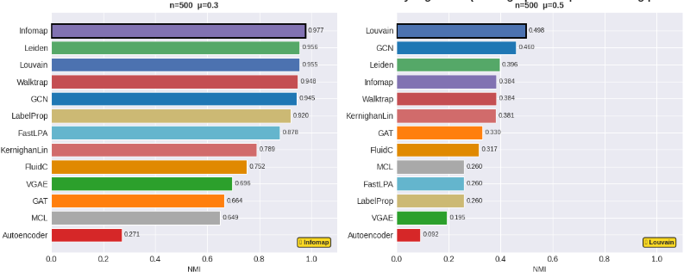
Results - LFR Benchmark
Community Detection Metrics - NMI

Slide 28
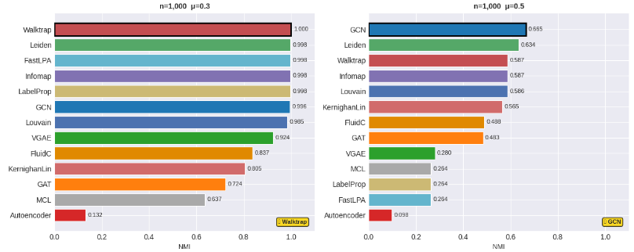
Results - LFR Benchmark
Community Detection Metrics - NMI

Slide 29
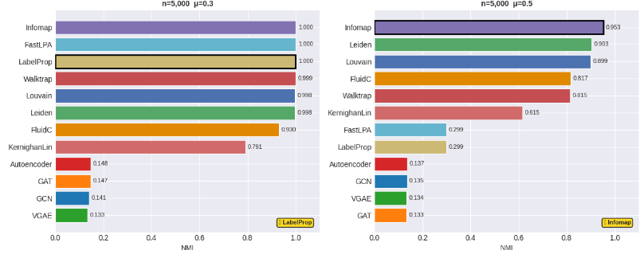
Results - LFR Benchmark
Community Detection Metrics - NMI

Slide 30
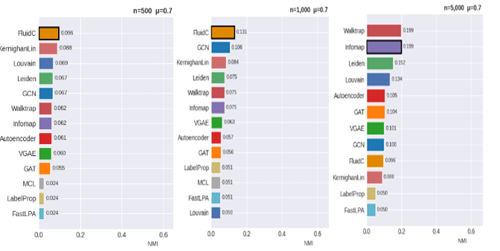
Results - LFR Benchmark
Community Detection Metrics - NMI

Slide 31
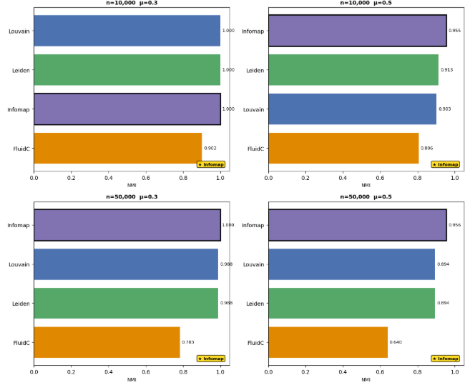
Results - LFR Benchmark
Community Detection Metrics - NMI

Slide 32
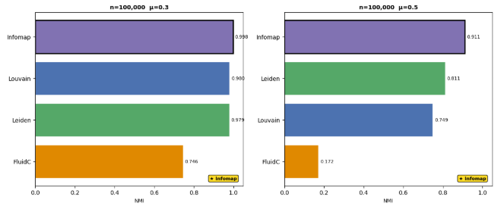
Results - LFR Benchmark
Community Detection Metrics - NMI

Slide 33
Results - Recommender System Integration
Hyperparameter Tuning Results
Model | Default Config | Default F1@5 | Tuned Config | Tuned F1@5
ALS | factors=20, reg=0.1, α=40 | 0.149 | factors=100, reg=0.1, α=10 | 0.371
BM25 | k1=1.5, b=0.75 | 0.178 | k1=3.0, b=1.0 | 0.211
SVD | n_components=50 | 0.277 | n_components=50 | 0.277

Slide 34
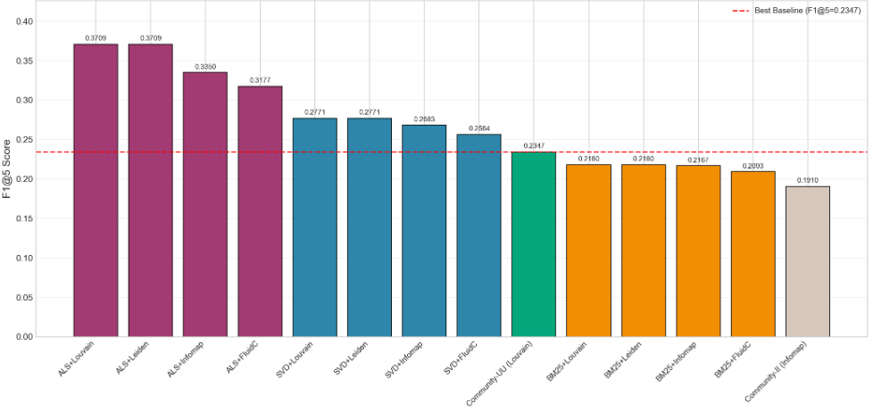
Results - Recommender System Integration
Performance Summary

Slide 35
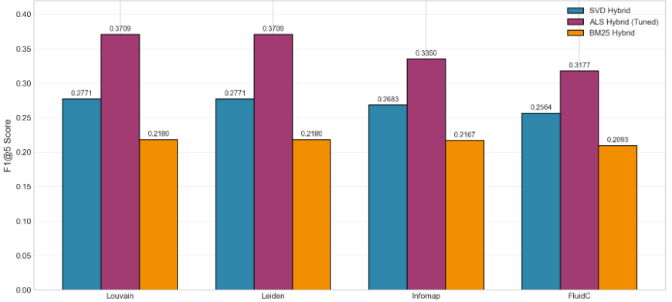
Results - Recommender System Integration
Performance Summary

Slide 36
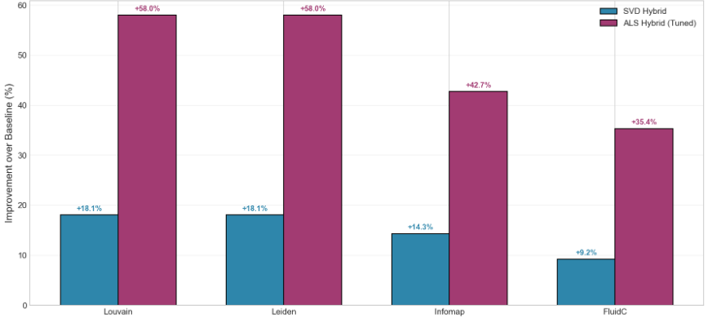
Results - Recommender System Integration
Performance Summary

Slide 37
WEB
APPLICATION

Slide 38
Discussion
Research Question: How do different community detection approaches compare in effectiveness and practical utility for recommender systems?
Classical algorithms (Louvain, Leiden, Infomap) remain the most effective and practical choice
Strengths | Details
High structural quality | Q > 0.81 on large networks
Excellent scalability | Near-linear time
Substantial RS improvements | +58% when combined with tuned ALS

Slide 39
Conclusion

Slide 40
Thank you for your attention

